Slide 1
Web Page Flow
Login Page
Home Page
Settings
Account Request
Configuration
Management

Slide 2

Login Page
LOGIN
Username
Password
Login
Request Account

Slide 3
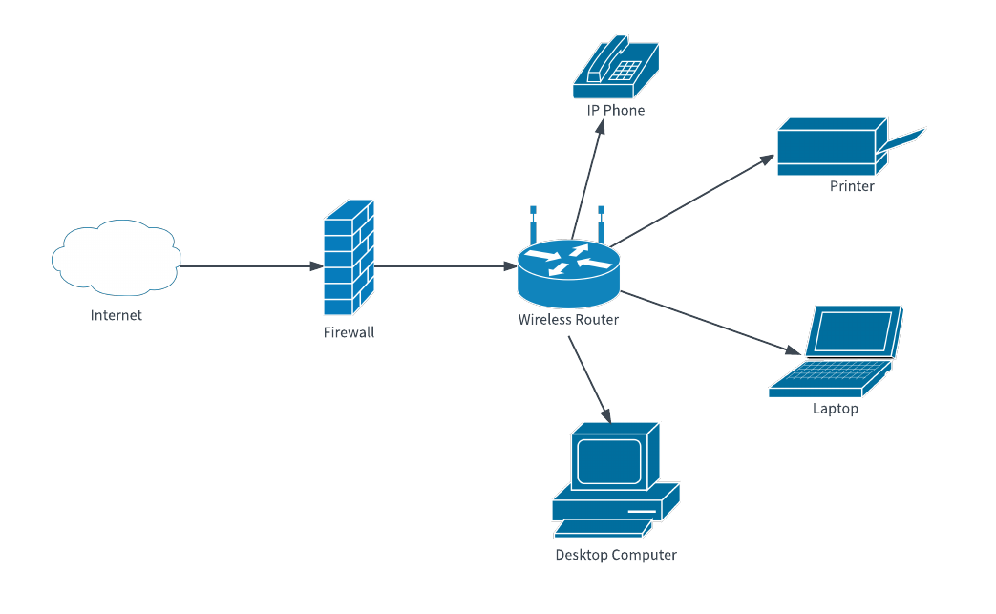
Home Page
Home | Configuration | Management | Settings
Network Information
List of connected devices in the network
Displays current network topology
Users can select a device to see details about that device and make changes

